Slide 1

OS Lab 4- Shell Scripting
Instructor
Aliza Saeed
aliza.saeed@nu.edu.pk

Slide 2
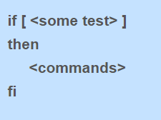
Decisions

Slide 3
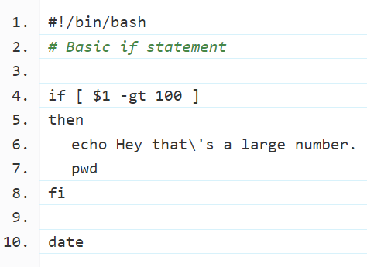
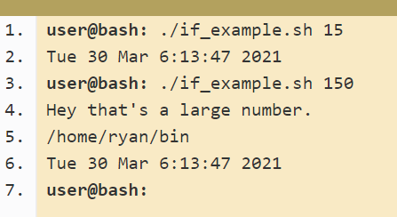
Example 1

Slide 4
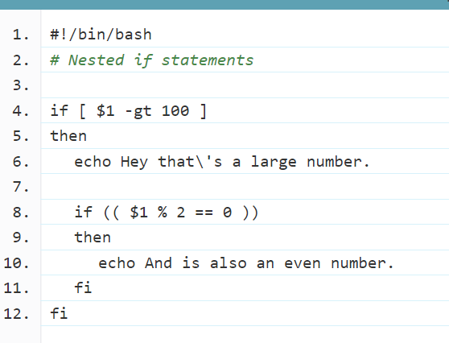
Nested If

Slide 5
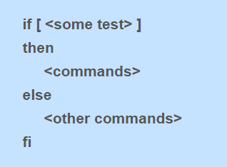
If-Else

Slide 6
Example
#!/bin/bash
# else example
if [ $# -eq 1 ]
then
echo happy
else
echo sad
fi

Slide 7
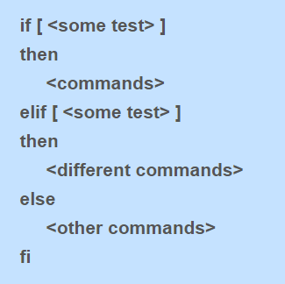
If-elif-else

Slide 8
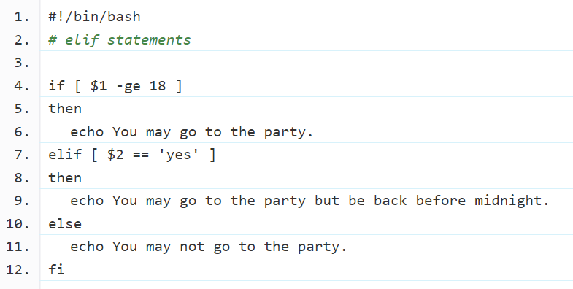
Example

Slide 9
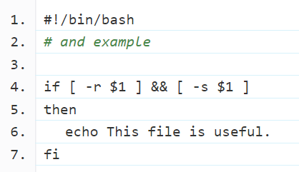
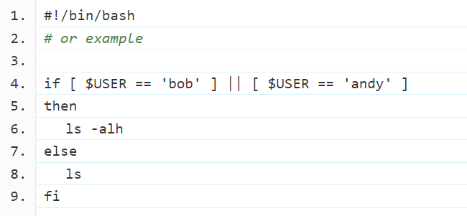
Boolean operations

Slide 10
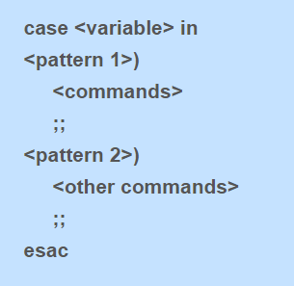
Case Statement

Slide 11
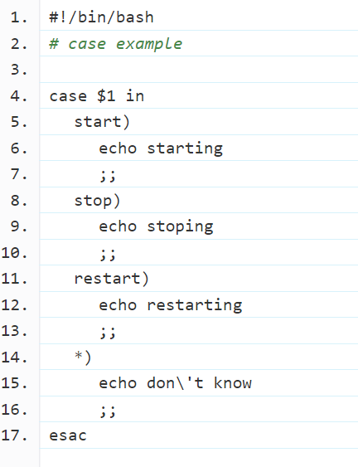
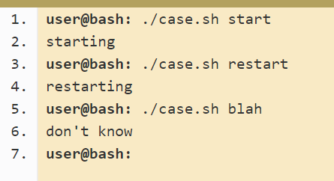
Example

Slide 12
LOOPS

Slide 13
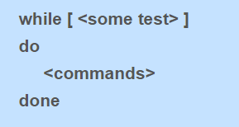
While Loop

Slide 14
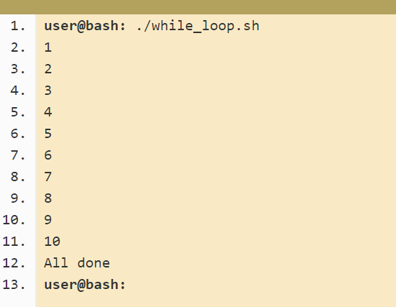
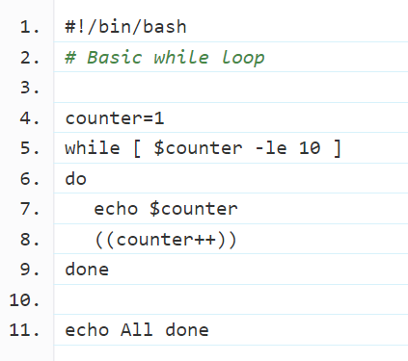
Example

Slide 15
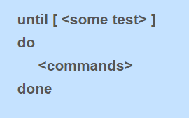
Until Loop

Slide 16
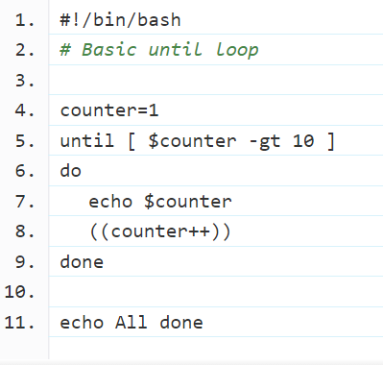
Example

Slide 17
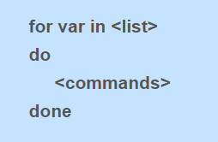
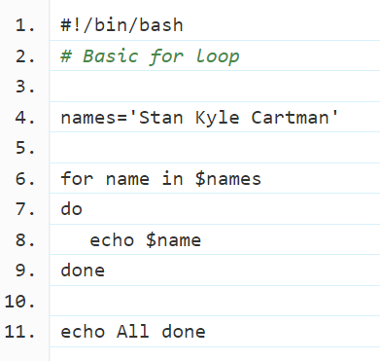
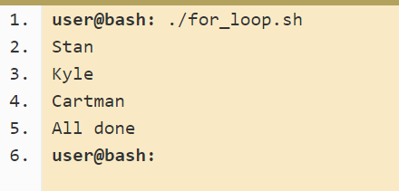
For Loop

Slide 18
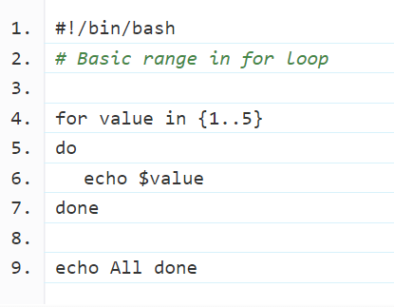
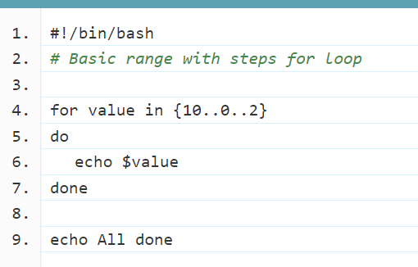
Ranges in for loop

Slide 19
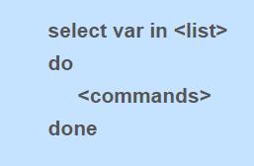
Select Statement

Slide 20
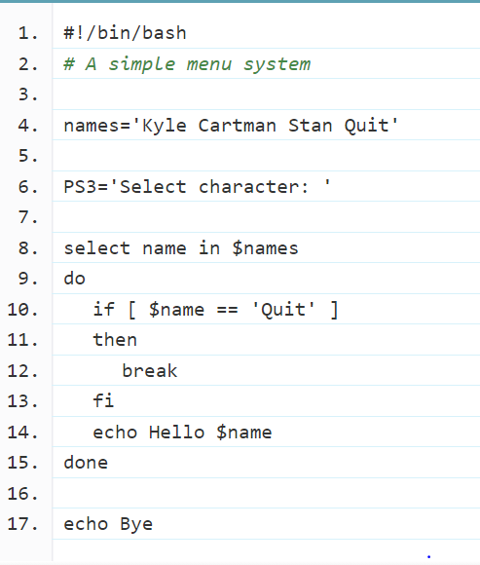
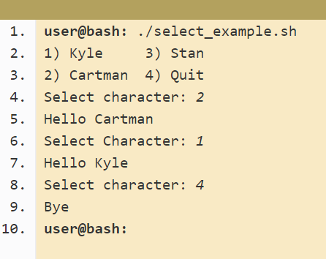
Example

Slide 21
Functions

Slide 22
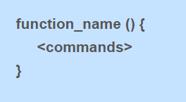
Simple function syntax
In other programming languages it is common to have arguments passed to the function listed inside the brackets (). In Bash they are there only for decoration and you never put anything inside them.
The function definition ( the actual function itself) must appear in the script before any calls to the function.

Slide 23
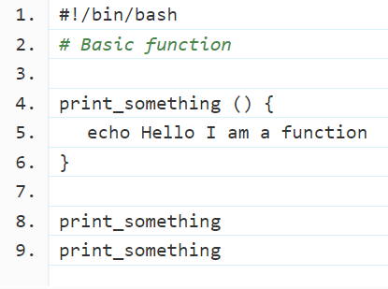
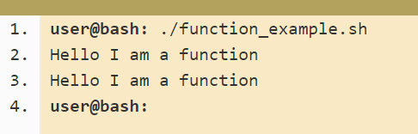
Example

Slide 24
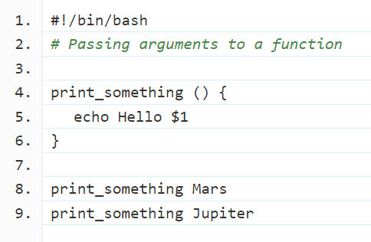
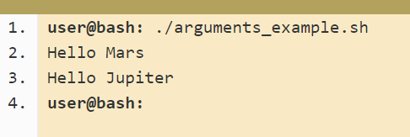
Passing Arguments

Slide 25
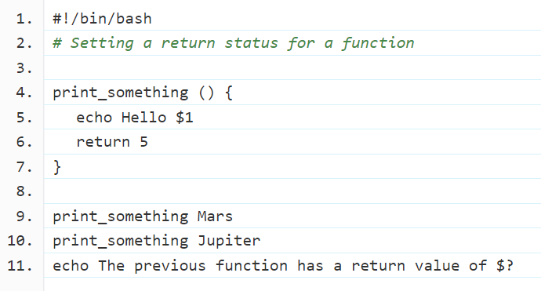
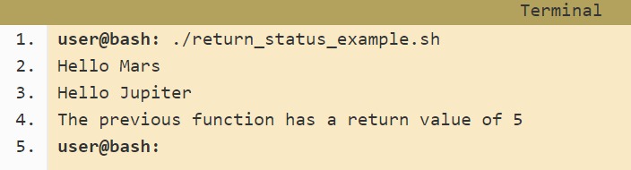
Returning Value

Slide 26
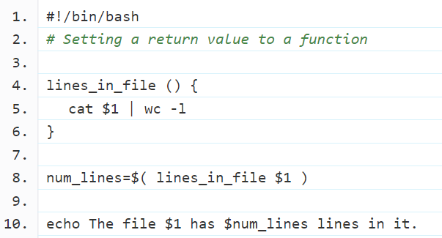
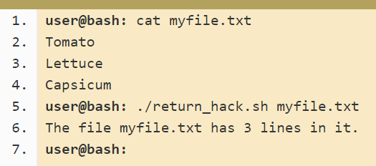
Returning Value (Alternate way)

Slide 27
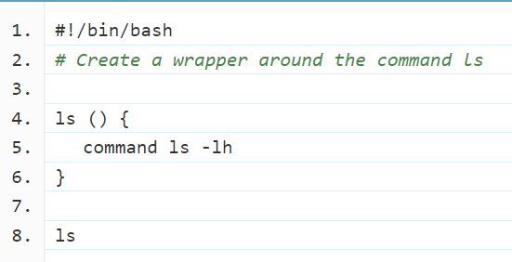
Overriding commands

Slide 28
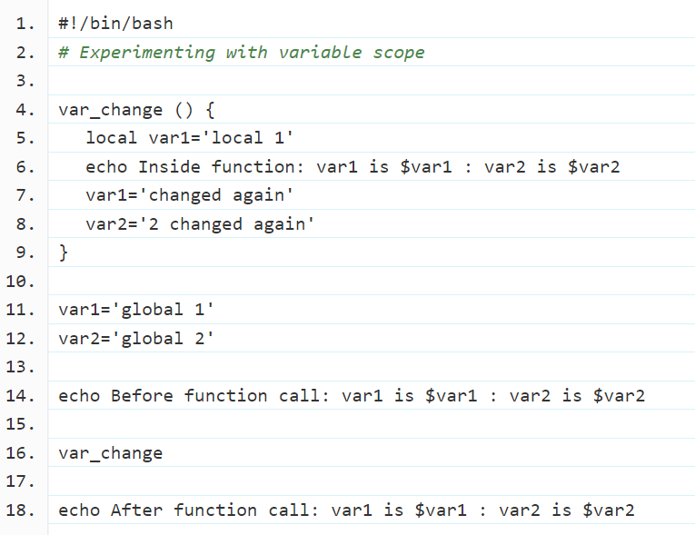

Variable scope

Slide 29
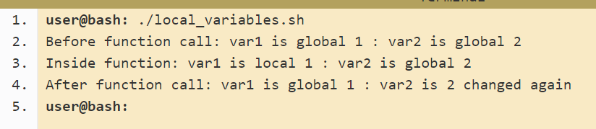
Example output

Slide 30
Built-in Functions
Built-in functions
Built- in functions are the function already defined in a programming language
the program does not require defining it
they directly use it with in their code
Some built-in functions are also defined in shell scripting e.g. random function etc.
Example:
num_rows=4
for ((i=1;i<=num_rows;i++))
do
echo $RANDOM
done

Slide 31
Built-in Functions
Built-in functions
Shift - shift [n] (Shift the positional parameters to the left by n)
Test- test expr ( evaluate a conditional expression and return status of 0/1)

Slide 32
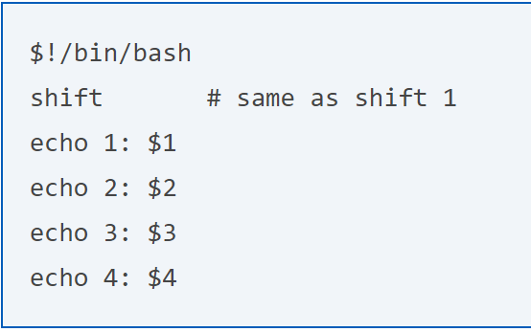
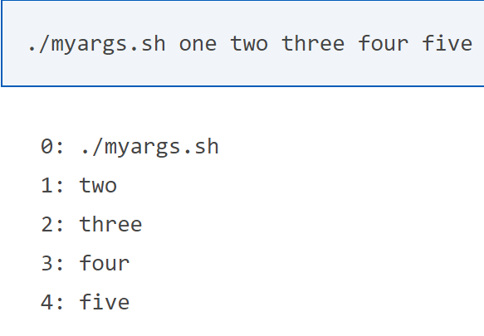

Slide 33
Recursive functions
A recursive function is a function that calls itself during its execution.
This enables the function to repeat itself several times
outputting the result at the end of each iteration

Slide 34
Recursive functions
You can write a recursive function in shell script
Example
array=(1 2 3 4)
f() {
if [ "$1 == -1 ]
then
return
else
a=$1
echo $((array[$a]))
f $((a-1)) #recursive function call
fi }
F 1 #function call with parameter

